Slide 1
L2 Web Application Architecture

Slide 2
The foundation for any software system is its architecture.
Software architecture is a view of the system that includes
the system’s major components,
the behaviour of those components as visible to the rest of the system,
and the ways in which the components interact and coordinate to achieve the overall system’s goal.

Slide 3
Client–server architecture
A client–server architecture divides an application into two parts, ‘client’ and ‘server’.
the server hosts, distributes and controls the majority of the resources as well as services to be used by the client.
The server provides the central functionality: i.e., any number of clients can connect to the server and request that it performs a task.
the server accepts the request , will process it and deliver the data packets requested back to the client.

Slide 4
Client–server architecture
the server computer has the potential to manage numerous clients at the same time.
a single client can connect to numerous servers at a single timestamp, where each server provides a different set of services to that specific client.
client–server architecture is also commonly called ‘two-tier architecture’.
the client and server can be two different computers in different parts of the world that are connected through the Internet. or could be within the same building.

Slide 5
Client–server architecture
for the client-server architecture on the web, specific factors need to be considered:
A specific set of languages along with a communication standard, exclusively a protocol for the interaction of two systems. The most popular are the HTTP and HTTPS (Hyper Text Transfer Protocol Secure).
Mechanism and protocol for requesting the required aspects from the server. That could be in any structure e.g. XML and JSON.
Next, the server responds by sending a reply in a structure of formatted data, (usually XML or JSON).

Slide 6
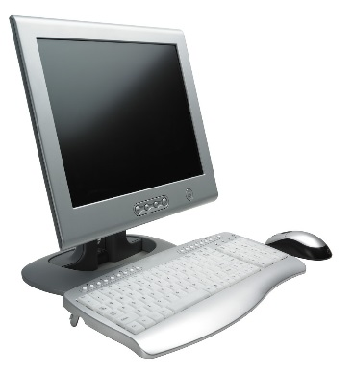
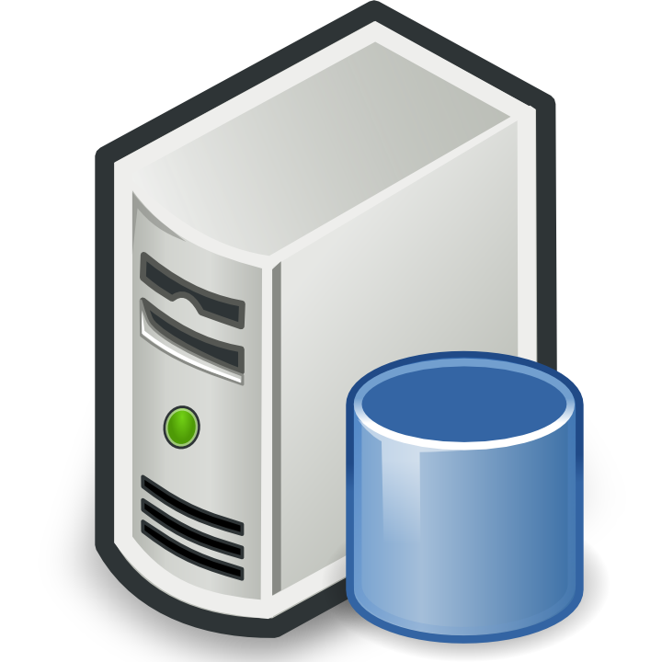
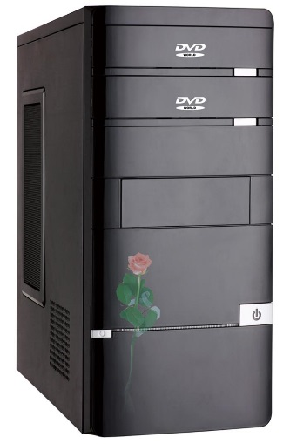
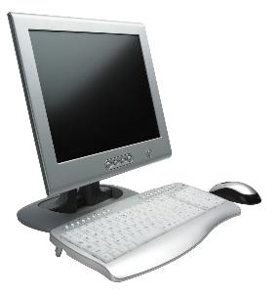
Client-Server Architecture
INTERNET
Client
Web Server
Database Server
Client
Client
E-mail Server

Slide 7
HTTP as the Transport
The communication layer between the client and the server is critical to the design and implementation of the application. The HyperText Transport Protocol (HTTP) defines how the request made by the client is received and handled by the server, and then how the information is sent back to the client.
The HTTP protocol does not understand the concept of a persistent connection between client and server.

Slide 8
How a web server processes static web pages

Slide 9
How static web pages work
Hypertext Markup Language, or HTML, is the language that the web browser converts into the web pages of a web application.
A static web page is an HTML document that’s stored in a file and does not change in response to user input.
Hypertext Transfer Protocol, or HTTP, is the protocol that web browsers and web servers use to communicate.
A web browser requests a page from a web server by sending the server a message known as an HTTP request. For a static web page, the HTTP request includes the name of the HTML file that’s requested.
A web server replies to an HTTP request by sending a message known as an HTTP response back to the browser. For a static web page, the HTTP response includes the HTML document.

Slide 10
How a web server processes a static web page
A simple HTTP request
GET / HTTP/1.1
Host: www.example.com
A simple HTTP response
HTTP/1.1 200 OK
Content-Type: text/html
Content-Length: 136
Server: Apache/2.2.3
<html>
<head>
<title>Example Web Page</title>
</head>
<body>
<p>This is a sample web page</p>
</body>
</html>

Slide 11
How a web server processes dynamic web pages

Slide 12
How dynamic web pages work
A dynamic web page is an HTML document that’s generated by a web application. Often, the web page changes according to parameters that are sent to the web application by the web browser.
When a web server receives a request for a dynamic web page, the server passes the request to the web application. Then, the application generates a response, which is usually an HTML document, and returns it to the web server.
The web server, in turn, wraps the generated HTML document in an HTTP response and sends it back to the browser.
The browser doesn’t know or care whether the HTML was retrieved from a static HTML file or was dynamically generated by the web application. Either way, the browser displays the HTML document that is returned.

Slide 13
Two protocols that web applications depend upon
HyperText Transfer Protocol (HTTP) is the protocol that web browsers and web servers use to communicate. It sets the specifications for HTTP requests and responses.
Transmission Control Protocol/Internet Protocol (TCP/IP) is a suite of protocols that let two computers communicate over a network

Slide 14
Java web applications

Slide 15
The components of a Java web application

Slide 16
An introduction to JavaServer Pages
A JavaServer Page, or JSP, consists of Java code that is embedded within HTML code.
When a JSP is first requested, the JSP engine translates it into a servlet and compiles it. Then, the servlet is run by the servlet engine.
The example that follows will use a html file to take in three parameters from the user and display the details back to the user\client using a JSP file

Slide 17
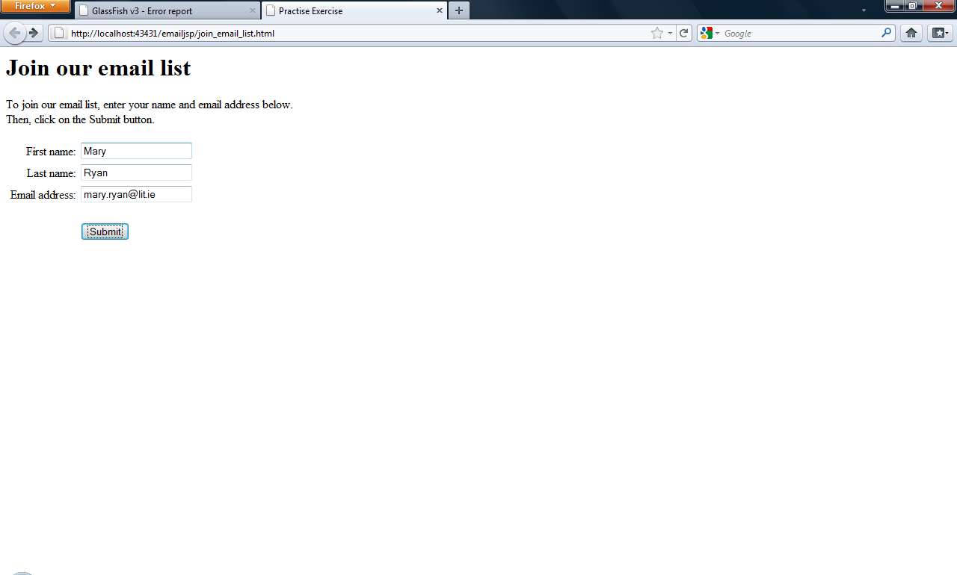
The HTML file that presents a form for the user to enter three parameters

Slide 18
<!DOCTYPE html>
<html>
<head>
<meta http-equiv="Content-Type" content="text/html; charset=UTF-8">
<title>Practise Exercise</title>
</head>
<body>
<h1>Join our email list</h1>
<p>To join our email list, enter your name and email address below. <br> Then, click on the Submit button.</p>
<form action="display_email_entry.jsp">
<table border="2">
<tbody>
<tr>
<td>First name:</td>
<td><input type="text" name="firstName" value="" /></td>
</tr>
<tr>
<td>Last name:</td>
<td><input type="text" name="lastName" value="" /></td>
</tr>
<tr>
<td>Email Address</td>
<td><input type="text" name="emailAddress" value="" /></td>
</tr>
</tbody>
</table>
<input type="submit" value="Submit" />
</form>
</body>
</html>

Slide 19
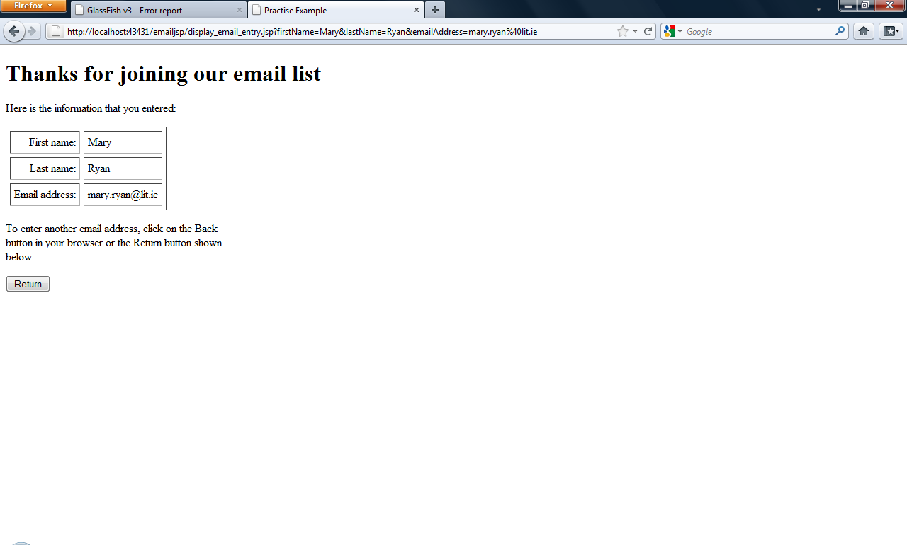
A JSP that displays three parameters entered by the user

Slide 20
A JSP that displays three parameters entered by the user
When a JSP is requested for the first time, the JSP engine (which is part of the servlet/JSP engine) converts the JSP code into a servlet and compiles the servlet. Then, the JSP engine loads that servlet into the servlet engine, which runs it. For subsequent requests, the JSP engine runs the servlet that corresponds to the JSP.

Slide 21
<html>
<head>
<title>Practise Example</title>
</head>
<body>
<%
// get parameters from the request
String firstName = request.getParameter("firstName");
String lastName = request.getParameter("lastName");
String emailAddress = request.getParameter("emailAddress");
%>
<h1>Thanks for joining our email list</h1>
<p>Here is the information that you entered:</p>
<table cellspacing="5" cellpadding="5" border="1">
<tr>
<td align="right">First name:</td>
<td> <%= firstName %> </td>
</tr>
<tr>
<td align="right">Last name:</td>
<td> <%= lastName %> </td>
</tr>
<tr>
<td align="right">Email address:</td>
<td> <%= emailAddress %> </td
</tr>
</table>
<p>To enter another email address, click on the Back <br>
button in your browser or the Return button shown <br>
below.
</p>
<form action=“Join_Email.html" method="get">
<input type="submit" value="Return">
</form>
</body>
</html>
Page 1
Page 2

Slide 22
<html>
<head>
<title>Practise Example</title>
</head>
<body>
<%
// get parameters from the request
String firstName = request.getParameter("firstName");
String lastName = request.getParameter("lastName");
String emailAddress = request.getParameter("emailAddress");
%>
<h1>Thanks for joining our email list</h1>
<p>Here is the information that you entered:</p>
<table cellspacing="5" cellpadding="5" border="1">
<tr>
<td align="right">First name:</td>
<td> <%= firstName %> </td>
</tr>
<tr>
<td align="right">Last name:</td>
<td> <%= lastName %> </td>
</tr>
<tr>
<td align="right">Email address:</td>
<td> <%= emailAddress %> </td
</tr>
</table>
<p>To enter another email address, click on the Back <br>
button in your browser or the Return button shown <br>
below.
</p>
<form action=“Join_Email.html" method="get">
<input type="submit" value="Return">
</form>
</body>
</html>
Page 1
JSP
expressions
Page 2
JSP
scriptlet

Slide 23
Introduction to Servlets
A Servlet is a Java class that runs on a server and does the processing for the dynamic web pages of a web application.
After the processing is done, a Servlet can return HTML code to the browser by using the println method of an out object.
The following slide will show code for a servlet that works the same as the JSP in previous slide.

Slide 24
HTML file calling a Servlet
<!DOCTYPE html>
<html>
<head>
<meta http-equiv="Content-Type" content="text/html; charset=UTF-8">
<title>Practise Exercise</title>
</head>
<body>
<h1>Join our email list</h1>
<p>To join our email list, enter your name and email address below.
<br> Then, click on the Submit button.</p>
<form action="displayEmailList">
<table border="2">
<tbody>
<tr>
<td>First name:</td>
<td><input type="text" name="firstName" value="" /></td>
</tr>
<tr>
<td>Last name:</td>
<td><input type="text" name="lastName" value="" /></td>
</tr>
<tr>
<td>Email Address</td>
<td><input type="text" name="emailAddress" value="" /></td>
</tr>
</tbody>
</table>
<input type="submit" value="Submit" />
</form>
</body>
</html>
This HTML page is exactly the same as the previous code on slide 22 with one significant difference - the action on the form is to call a servlet named displayEmailList instead of a JSP file.

Slide 25
Code for a servlet that works the same as the JSP
out.println("<!DOCTYPE html>");
out.println("<html>");
out.println("<head>");
out.println("<title>Servlet tesst</title>");
out.println("</head>");
out.println("<body>");
out.println("<h1>Thanks for joining our email list</h1>");
out.println("<p>Here is the information that you entered:</p>");
out.println("<table cellspacing=\"5\" cellpadding=\"5\" border=\"1\">");
out.println(" <tr><td align=\"right\">First name:</td> ");
out.println( " <td>" + firstName + "</td> ");
out.println( " </tr> ");
out.println( " <tr><td align=\"right\">Last name:</td>");
out.println( " <td>" + lastName + "</td> ");
out.println( " </tr>");
out.println(" <tr><td align=\"right\">Email address:</td>");
out.println( " <td>" + emailAddress + "</td>");
out.println(" </tr>");
out.println( " </table>");
out.println( "<p>To enter another email address, click on the Back <br>");
out.println( "button in your browser or the Return button shown below.</p>");
out.println( "<form action=\"Join_Email.html\">");
out.println(" <input type=\"submit\" value=\"Return\"> ");
out.println("</body>");
out.println("</html>");
out.close();
}
}
package Email;
import java.io.IOException;
import java.io.PrintWriter;
import javax.servlet.ServletException;
import javax.servlet.http.HttpServlet;
import javax.servlet.http.HttpServletRequest;
import javax.servlet.http.HttpServletResponse;
public class DisplayEmailEntryServlet extends HttpServlet {
protected void doGet(
HttpServletRequest request,
HttpServletResponse response)
throws ServletException, IOException
{
// get parameters from the request
String firstName =
request.getParameter("firstName");
String lastName = request.getParameter("lastName");
String emailAddress =
request.getParameter("emailAddress");
response.setContentType("text/html;charset=UTF-8");
PrintWriter out = response.getWriter();

Slide 26
Code for a servlet that works the same as the JSP
"<!doctype html public \n"
+ "-//W3C//DTD HTML 4.0 Transitional//EN\">\n"
+ "<html>\n"
+ "<head>\n"
+ " <title>Display Email Details using Servlets<title>\n"
+ "</head>\n"
+ "<body>\n"
+ "<h1>Thanks for joining our email list</h1>\n"
+ "<p>Here is the information that you entered:</p>\n"
+ " <table cellspacing=\"5\" cellpadding=\"5\" "
+ "border=\"1\">\n"
+ " <tr><td align=\"right\">First name:</td>\n"
+ " <td>" + firstName + "</td>\n"
+ " </tr>\n"
+ " <tr><td align=\"right\">Last name:</td>\n"
+ " <td>" + lastName + "</td>\n"
+ " </tr>\n"
+ " <tr><td align=\"right\">Email address:</td>\n"
+ " <td>" + emailAddress + "</td>\n"
+ " </tr>\n“
+ " </table>\n"
+ "<p>To enter another email address, click on the Back <br>\n"
+ "button in your browser or the Return button shown below.</p>\n"
+ "<form action=\"join_email_list.html\" >\n"
+ " <input type=\"submit\" value=\"Return\">\n"
+ "</form>\n"
+ "</body>\n"
+ "</html>\n");
out.close();
}
}
This servlet will generate the same web page as the JSP code given on previous slide.
Each Servlet is a java class that extends the HttpServlet class.
Every servlet can override the doGet method of the inherited class, which receives both a request and a response object from the web server, and the servlet can get the parameters that have been passed to it by using the getParameter method of the request object.
After that the servlet can do whatever processing is required by using normal Java code.
package email;
import java.io.*;
import javax.servlet.*;
import javax.servlet.http.*;
public class DisplayEmailEntryServlet extends HttpServlet
{
protected void doGet(
HttpServletRequest request,
HttpServletResponse response)
throws ServletException, IOException
{
// get parameters from the request
String firstName =
request.getParameter("firstName");
String lastName = request.getParameter("lastName");
String emailAddress =
request.getParameter("emailAddress");
// return response to browser
response.setContentType("text/html;charset=UTF-8");
PrintWriter out = response.getWriter();
out.println(

Slide 27
Three environments for servlet and JSP development

Slide 28
The architecture for a typical Java web application
The presentation layer for a typical Java web application consists of HTML pages and JSPs.
The business rules layer for a typical Java web application consists of servlets. These servlets may call other Java classes including a special type of Java class known as a JavaBean.
The data access layer for a typical Java web application consists of classes that read and write data that’s stored on the server’s disk drive.
For a serious web application, the data is usually stored in a relational database. However, it may also be stored in binary files, in text files, or in Extensible Markup Language (or XML) files.

Slide 29
References
https://www.open.edu/openlearn/science-maths-technology/introduction-web-applications-architecture/content-section-2
https://www.peerbits.com/blog/web-application-architecture.html
https://www.scnsoft.com/blog/web-application-architecture#web-app-architecture
https://www.w3schools.in/what-is-client-server-architecture/

